Slide 1

Retail Data Analysis
Excel
Dikshant Sharma

Slide 2
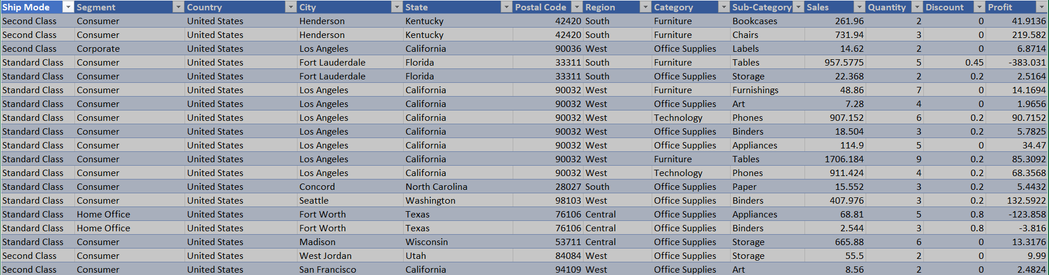
Retail Data Analysis
Data Source: https://data.world/codefordc/retail
Data :
Top 20 Rows

Slide 3
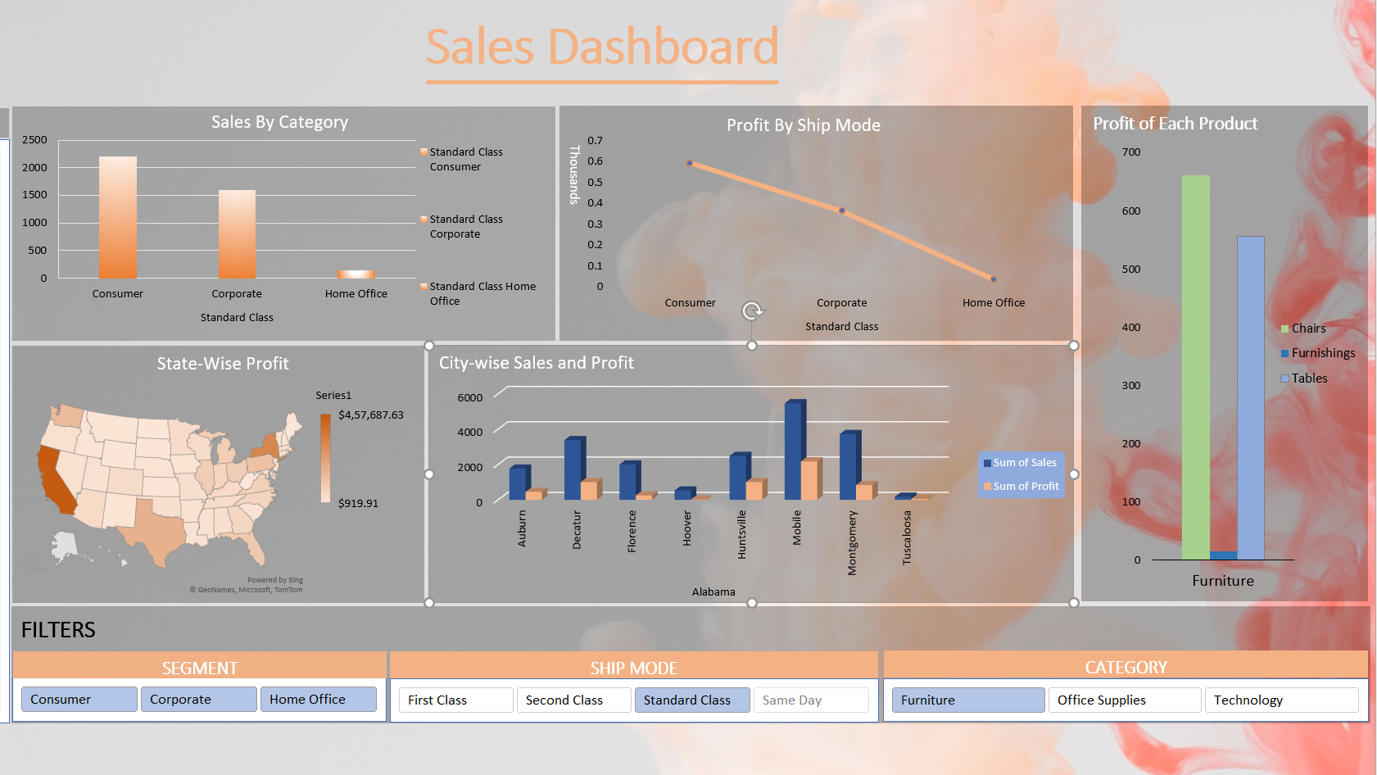
Dashboard

Slide 4
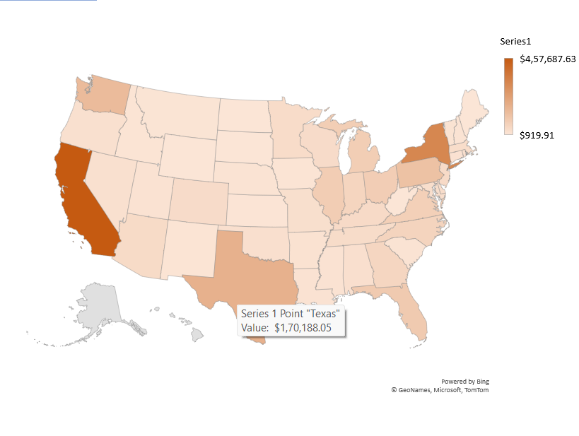
Sales By State

Slide 5
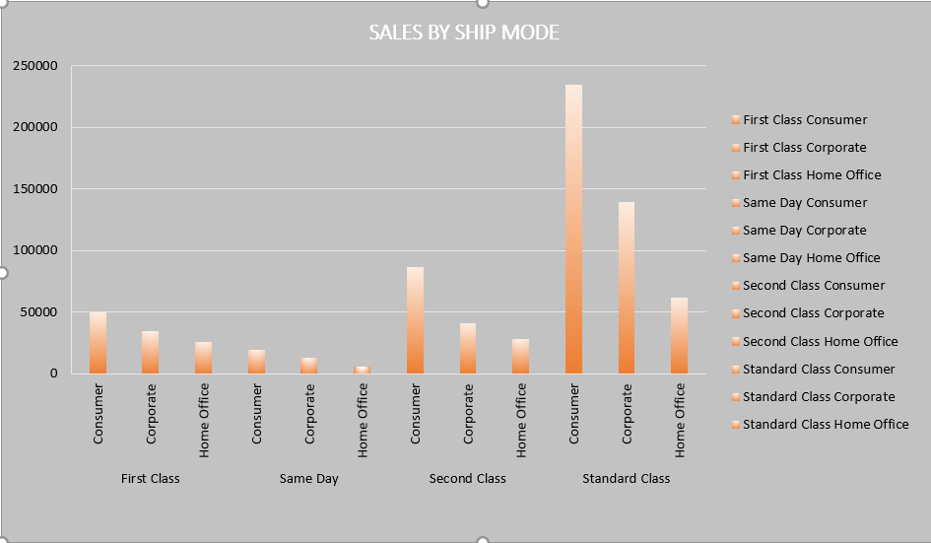
Sales In Category By Mode of Shipping

Slide 6
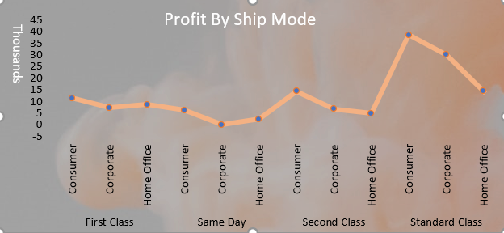
Profit In Category By Mode of Shipping

Slide 7
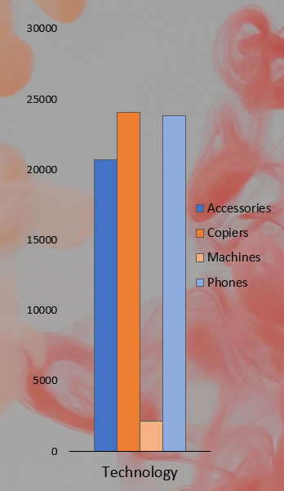
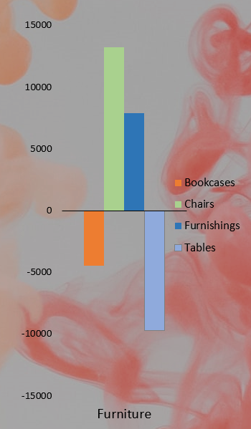
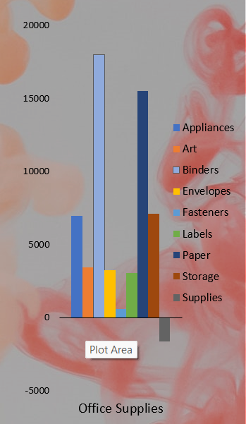
Profit of each Product by Category

Slide 8
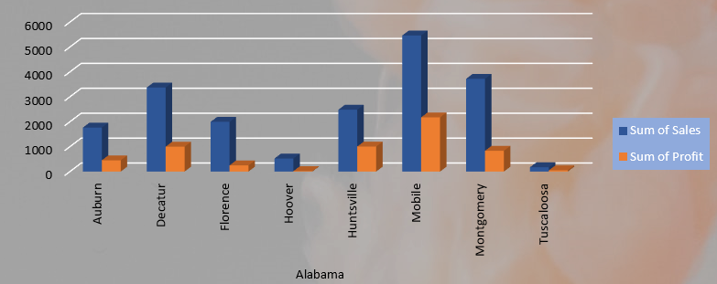
Sales and Profit In each City by State

